Slide 1
Quarterly HR Community Meeting
Human Resources Administration
May 21, 2019

Slide 2
Quarterly HR Community Meeting
AGENDA
May 21, 2019, 10:00am – 12:00pm
DNR Board Room, 12th Floor, East Tower
Welcome Al Howell
Human Trafficking Prevention Training First Lady of Georgia
Marty Kemp
EAP Update Susan Baker, KEPRO
                VP Operations
Emotional Intelligence for HR Professionals Conrad Norman
Meeting Wrap-up Al Howell
Join us for an informal HR Community lunch in the cafeteria following the meeting.

Slide 3
Human Trafficking Prevention Training
First Lady of Georgia Marty Kemp

Slide 4
EAP Update
Susan Baker, KEPRO, VP Operations

Slide 5


State of Georgia
KEPRO Presentation
Employee Assistance Program

Slide 6
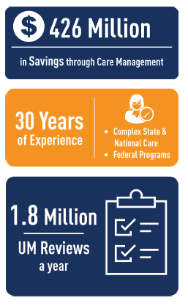
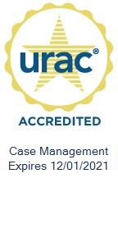


KEPRO Introduction
Who We Are
Since 1985, KEPRO has helped members lead healthier lives through clinical expertise, integrity and compassion. KEPRO was founded by physicians and clinical expertise is at the core of our organization.
Currently servicing over 250 Contracts within commercial, public and federal clients
URAC accredited in UM, CM, DM
16 offices and more than 1,400 employees
EAP provider network 15K
2

Slide 7
State of Georgia – Member Support
Counseling & Member Support
24/7/365 clinical support
100% of calls answered by KEPRO Masters level counselors
4, 6 & 8 Face to Face models
Georgia and nationwide network of EAP providers
100% follow up and appointment setting
Work Life Services:
Legal & Financial Consultation
Child, Eldercare and Daily Living Support
Geriatric Case Management optional
EAPHelplink.com
Robust website designed to support program
Co-Branded
3

Slide 8
Organizational Support
Organizational Services
24/7/365 clinical support for leadership
Management consultation and support related to employee performance concerns
Access to expert team of workplace specialists with experience in:
Work place violence prevention
Aberrant employee behavior
Critical incident support – telephonic and onsite CIS
Substance misuse/DOT/SAP optional
Onsite training – over 100 topics to choose from
Training hours
> 5500 employees = 20 hours per year
4000 – 5499 = 16 hours per year
2500 to 3999 = 12 hours per year
1000 to 2499 = 8 hours per year
500 – 1000 employees = 4 hours per year
< 500 = 1 hour per year
4

Slide 9
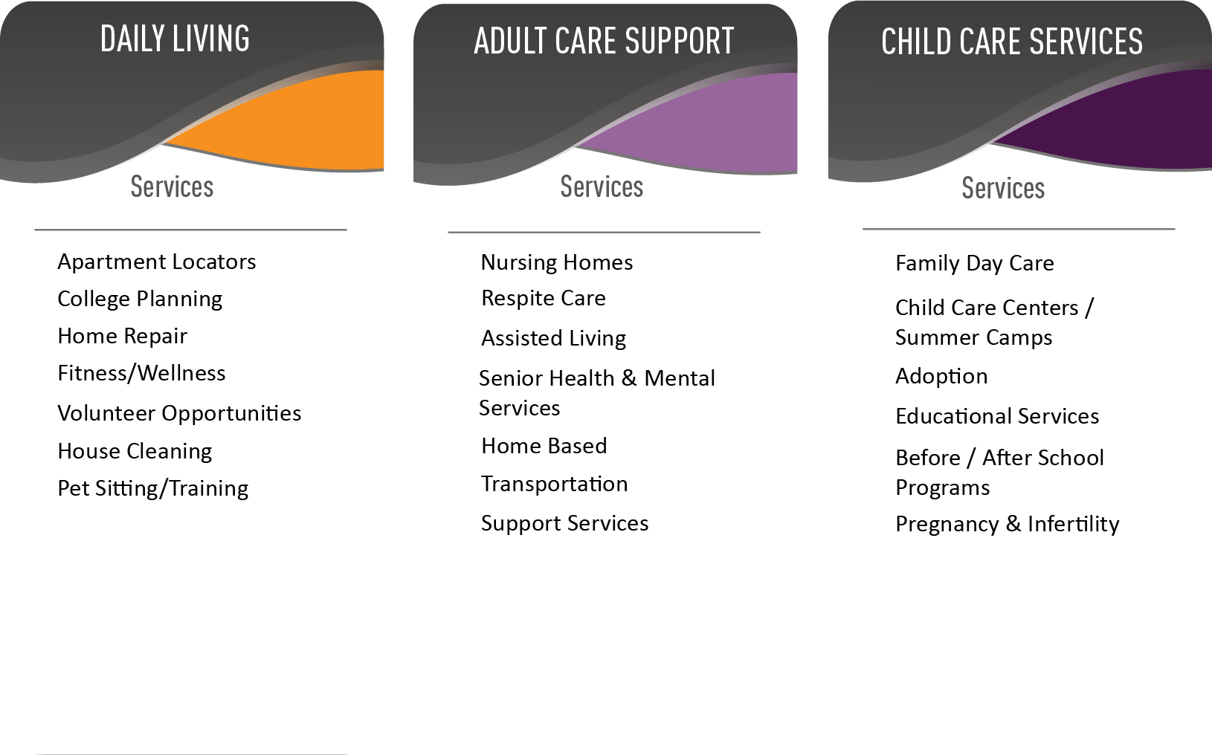
Work Life Services
5

Slide 10
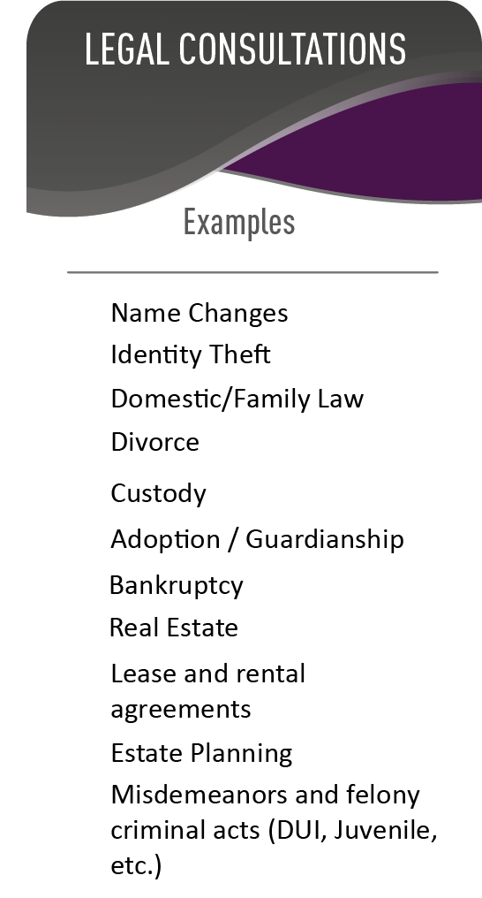
Legal Services
Up to 30 minute consultation with local attorney (in person or via telephone).
Network credentialed attorneys – minimum five years experience in practice. Must be member of local bar association, possess an active license and maintain malpractice insurance.
If member wishes to retain the attorney they may do so at a 25% discount.
Mediation services also included in benefit. Same discount applies if they chose to retain the services of the mediator.
6

Slide 11
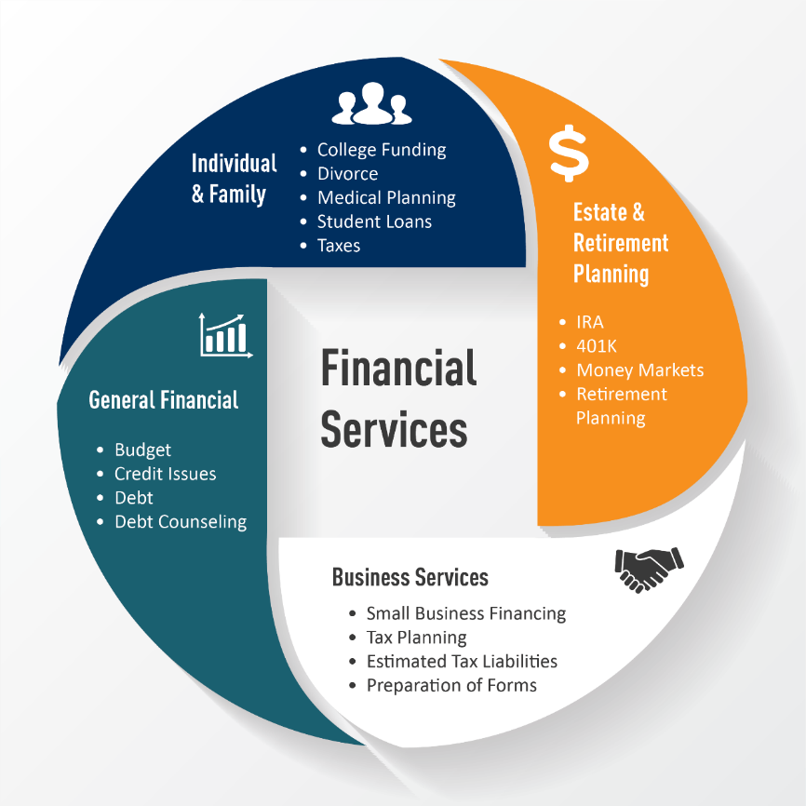
Financial Services
7

Slide 12
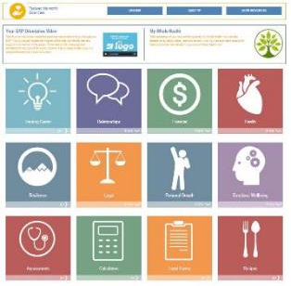
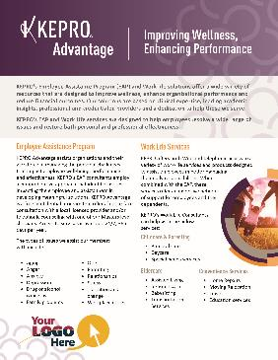


Program Launch
Week of May 27th – Launch conference calls to provide overview of transition and next steps.
Week of June 10th – Electronic materials sent to each agency along with Q/A related to transition.
Week of June 17th – Brochures and wallet cards mailed to agency
Beginning June 24th – KEPRO will accept transferred calls from current vendor for clients wishing to schedule face to face appointment after July 1.
July 1 – KEPRO program live
8

Slide 13
Next Steps & KEPRO Key Staff
Submit signed participation agreement to Susan Baker
Provide follow up information related to head count and key contact(s)
Attend one of the launch sessions week of May 27th for updates on launch
Watch for materials week of June 17th
Susan Baker – Market Vice President
Email – smbaker@kepro.com
Yvonne Zuckerman – Account Manager
Email – yzuckerman@kepro.com
9

Slide 14
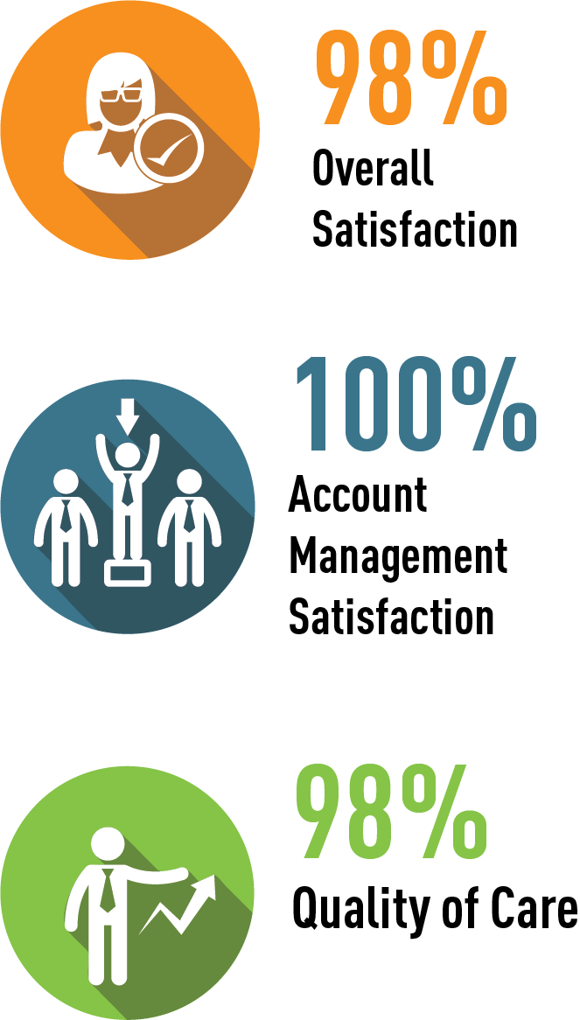
Customer Satisfaction & Results
    Strong History of Performance and Customer Satisfaction
    2018 Annual Satisfaction and Outcomes
    99% of utilizers would recommend the program to others
    97% of utilizers would use the program again
    93% of members report improved functioning at work
    96% of members report the ability to manage problems better
    98% of the members report overall satisfaction with the program
10

Slide 15
Emotional Intelligence for HR Professionals
Conrad Norman

Slide 16


Slide 17


Slide 18

IQ
EQ

Slide 19


Slide 20
Emotional Intelligence…What it’s Not
Emotional Intelligence is not about being “nicer”
or “more polite”
X
Emotional Intelligence is not about you trying to “get in touch with your sensitive side”
X
Emotional Intelligence is not about you becoming more “caring” or “touchy-feely”
X
Emotional Intelligence is not about learning to
be more “emotional”
Emotional Intelligence is not something you are born with or “You either have it or you don’t”

Slide 21

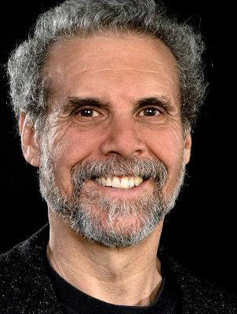

Slide 22
5 Components (EQ)
Self-Awareness
X
Self-Regulation
X
Motivation
X
Empathy
X
Social Skills

Slide 23

EQ is more than twice as predictive of performance and success than IQ

Slide 24


Slide 25
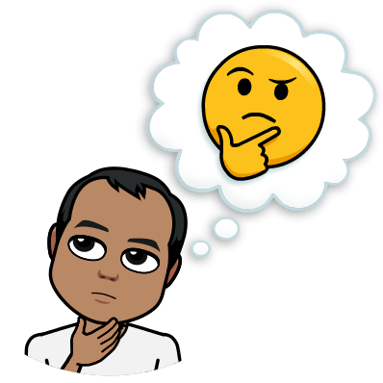
What exactly is Emotional Intelligence?

Slide 26
Emotional Intelligence (EQ) is a different way of being smart. EQ is the ability to recognize your emotions, understand what they’re telling you, and realize how your emotions affect people around you. It also involves your perception of others: when you understand how they feel, this allows you to manage relationships more effectively.

Slide 27
“Emotional intelligence, more than any other factor, more than I.Q. or expertise, accounts for 85% to 90% of success at work. I.Q. is a threshold competence. You need it, but it doesn’t make you a star. Emotional Intelligence can…” Warren Bennis Founding Chairman of The Leadership Institute

Slide 28
What I See
Personal Competence
Relational Competence
Self Awareness
Awareness of Others
Self Control
Building Relationships
What I Do

Slide 29
How well you know yourself in comparison to how others perceive you.
Self Awareness
Awareness of Others
Self Control
Building Relationships

Slide 30
What are my strengths and weaknesses?
Self Awareness
Awareness of Others
Self Control
Building Relationships

Slide 31
Does my perception of myself align with how others see me?
Self Awareness
Awareness of Others
Self Control
Building Relationships

Slide 32
Where am I confident about my skills and abilities?
Self Awareness
Awareness of Others
Self Control
Building Relationships

Slide 33
How well you manage your emotions and actions.
Self Awareness
Awareness of Others
Self Control
Building Relationships

Slide 34
What can I do to manage myself when under stress?
Self Awareness
Awareness of Others
Self Control
Building Relationships

Slide 35

The “Amygdala hijack”

Slide 36
How do my values shape or influence what I say and what I do?
Self Awareness
Awareness of Others
Self Control
Building Relationships

Slide 37
When do I take initiative to resolve conflict or solve problems?
Self Awareness
Awareness of Others
Self Control
Building Relationships

Slide 38
What I See
Personal Competence
Relational Competence
Self Awareness
Awareness of Others
Self Control
Building Relationships
What I Do

Slide 39
Emotions
Strengths
Weaknesses
Self Awareness
Awareness of Others
Self Control
Building Relationships
Needs Preferences
Values

Slide 40
Self Awareness
Awareness of Others
Self Control
Building Relationships
Do you know how to accurately read others’ emotions, both individually and in group settings?

Slide 41
Self Awareness
Awareness of Others
Self Control
Building Relationships
Can you anticipate the feelings needs and concerns of others?

Slide 42
Self Awareness
Awareness of Others
Self Control
Building Relationships
How do you cultivate your appreciation of diverse thoughts and experiences?

Slide 43
How we utilize our awareness of others to maximize their potential and our relationship
Self Awareness
Awareness of Others
Self Control
Building Relationships

Slide 44
How do you help others grow and maximize their potential?
Self Awareness
Awareness of Others
Self Control
Building Relationships

Slide 45
Can you identify the difference between healthy and toxic conflict?
Self Awareness
Awareness of Others
Self Control
Building Relationships

Slide 46
Can you persuade and influence others with your ideas or vision?
Self Awareness
Awareness of Others
Self Control
Building Relationships

Slide 47


Slide 48
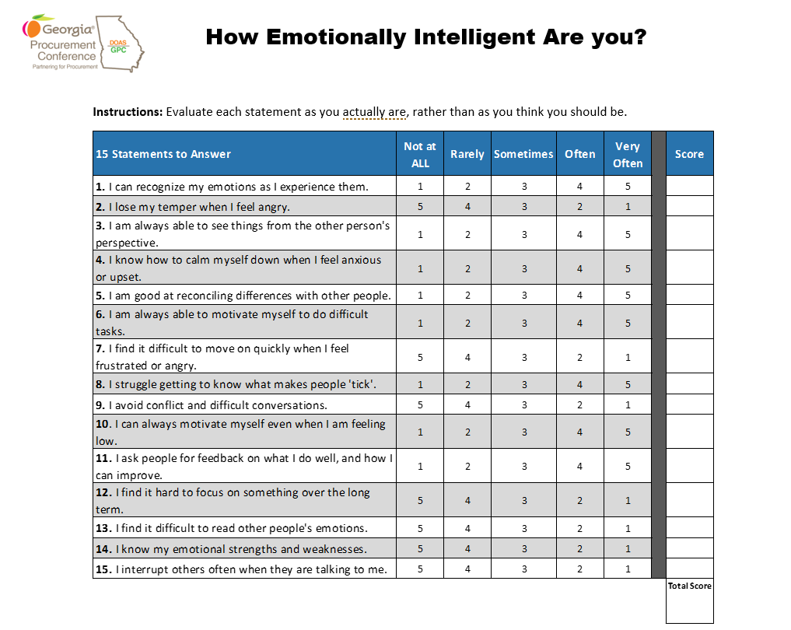


Slide 49


Slide 50

Score Interpretation
Score (15-34)
There is a real opportunity for you to work on developing your emotional intelligence. You may find you feel at times overwhelmed by your emotions, especially in stressful situations; or, you may avoid conflict. It's likely, too, that you find it hard to calm down after you've felt upset, and you may struggle to build strong working relationships.
Score (35-55)
Your emotional intelligence level is...OK. You probably have good relationships with some of your colleagues or customers, but others may be more difficult to work with. Work to boost your EI still further.
Score (56-75)
You’re likely an emotionally intelligent person. You have great relationships, and you probably find that people approach you for advice. Even so, it's easy
to lose sight of your own needs. Seek opportunities to improve even further.

Slide 52


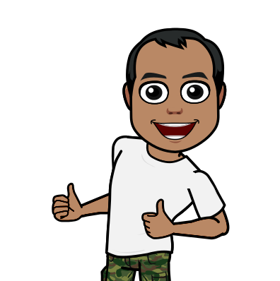

Slide 53
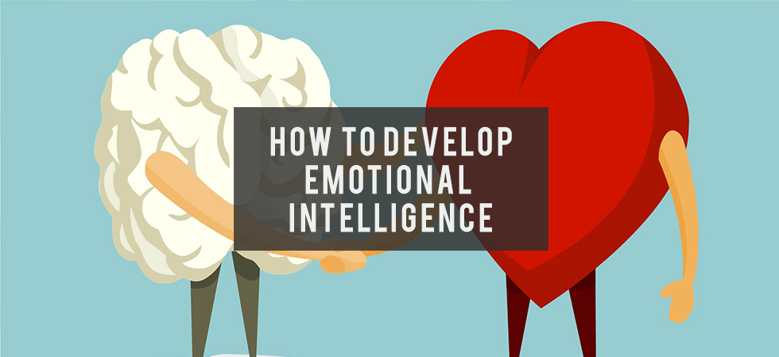

Slide 54
Emotional intelligence can be learned and developed.
Followed are strategies and considerations you can use to develop or improve your emotional intelligence:
Do a self-evaluation. What are your weaknesses? Are you willing to accept that you're not perfect and that you could work on some areas to make improve your EQ?
Observe how you react to people. Do you rush to judgment before you know all of the facts? Do you stereotype? Look honestly at how you think and interact with other people. Try to put yourself in their place, and be more open and accepting of their perspectives and needs.
Examine how you react to stressful situations. Do you become upset every time there's a delay or something doesn't happen the way you want? Do you blame others or become angry at them, even when it's not their fault? Keep your emotions under control when things go wrong.
Take responsibility for your actions. If you hurt someone's feelings, apologize directly – don't ignore what you did or avoid the person. People are usually more willing to forgive and forget if you make an honest attempt to make things right.

Slide 55
Consider how your negative emotions (anger, jealously, frustration, disengagement, etc.) may have impacted your boss, customers, and co-workers in the past. Acknowledge the fallout and repercussions of your behavior.
Think about ways you can manage your emotions on the job so you don't have knee-jerk reactions or make inappropriate or off-putting comments.
Practice waiting a few minutes or hours before responding or making a decision when a situation is emotionally-charged or difficult.
Accept that uncertainty, frustrations, and disappointments are simply part of any work environment. Rather than complaining or acting out, brainstorm alternatives or solutions that might be beneficial. Present those ideas in a professional and calm way.
Examine how your actions will affect others – before you take those actions. If your decision will impact others, put yourself in their place. How will they feel if you do this? Would you want that experience? If you must take the action, how can you help others deal with the effects?

Slide 56
Consciously try to view situations from the other person's point of view. This is particularly important in conflict situations that can easily create a stalemate. Recognize that we're all working from the knowledge and experiences we have — rather than judging the person as right or wrong or good or bad.
In addition to looking at the person's point of view, actually validate it. Let them know you understand where they're coming from and that their perspective has merit.
Examine your own attitude and motives. Do you just want to be right, to prove a point or win the argument, or are you truly interested in the best outcome or solution, even if it's not yours?
Practice active listening and reflect back what the other person is saying, so it's clear you both understand what's being communicated. When people feel heard, they tend to be more willing to cooperate and compromise.
Understand the person you're talking to. You can't have a one-size-fits-all approach to interacting with everyone in the workplace. You need to know how to finesse and tailor an interaction to the person involved, based on their personality, feelings, cultural orientation, and role/position.

Slide 57
“We are being judged by a new yardstick; not just how smart we are, or by our qualifications and expertise, but also how well we handle ourselves and each other…”
Daniel Goleman, Ph.D.

Slide 58
Meeting Wrap-up
Al Howell

Slide 59
2019 HR Community Meeting
Dates and Topics
Tuesday, August 20th
Flexible Benefits Update
Tuesday, November 19th
FMLA and ADA

Slide 60
Other Upcoming HR Meetings
Wednesday, June 12th
HR Practices Advisory Committee Meeting
*meetings are held monthly on the second Wednesday of each month thru the end of the year
Tuesday, July 9th
Employee Benefit Plan Council/State Personnel Board Meeting
*other meetings are also scheduled for September 10, 2019 and November 12, 2019
Wednesday, July 17th
Team Georgia Careers User Group Meeting
CSPA Conference in Savannah September 4-6

Slide 61
404-463-7054

